Slide 1


Special topics
Session 4
Al-Zahra university
Maryam zim
@maryamzim maryamxiim@gmail.com

Slide 2




Border-radius
property defines the radius of the element's corners.
This property allows you to add rounded corners to elements!
Four values - border-radius: 15px 50px 30px 5px; (first value applies to top-left corner, second value applies to top-right corner, third value applies to bottom-right corner, and fourth value applies to bottom-left corner):
Three values - border-radius: 15px 50px 30px; (first value applies to top-left corner, second value applies to top-right and bottom-left corners, and third value applies to bottom-right corner):
Two values - border-radius: 15px 50px; (first value applies to top-left and bottom-right corners, and the second value applies to top-right and bottom-left corners):
One value - border-radius: 15px; (the value applies to all four corners, which are rounded equally:

Slide 3
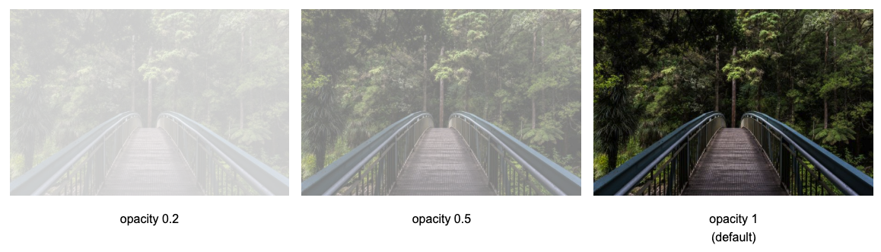
Opacity:
The opacity describes the transparency, where 1 is not transparent at all, 0.5 is 50% see-through, and 0 is completely transparent.
پرده هارو سرکلاس بکشیم استاد چه شکلی دیده میشه ؟
😀

Slide 4
Fonts
CSS Fonts are a set of properties used to control the appearance, style, size, and weight of text on a web page. They allow web designers to select the specific typeface (font family) that the browser should use to display text, ensuring consistency and enhancing readability across different devices.
Here are the most important CSS properties used for controlling text:
Property | Description | Example
font-family | Specifies the typeface (font name) to be used. It can list several font names as a fallback system. | font-family: Arial, sans-serif;
font-size | Sets the size of the text. Can be defined using pixels (px), relative units (em, rem), or percentages (%). | font-size: 16px;
font-weight | Controls the thickness or boldness of characters. Values are typically keywords (bold, normal) or numbers (100 to 900). | font-weight: bold;
font-style | Specifies whether the font should be displayed in a normal, italic, or oblique face. | font-style: italic;
line-height | Sets the height of a line of text, which determines the vertical space between lines (leading). | line-height: 1.5;

Slide 5
At-rules:
At-rules are special commands in CSS that start with an at symbol (@). They instruct the CSS engine on how to behave, such as importing external stylesheets, defining custom fonts, or managing keyframe animations.
@font-face:
This is a type of at-rules that allows you to define and load custom web fonts that are not necessarily installed on the user's computer.
@font-face {
font-family: 'MyCustomFont';
src: local(’custom-font’) url('fonts/custom-font.woff2') format('woff2');
font-weight: 400;
font-style: normal;
}
Using local() and url() is common. Why?
Because if the font is on the user's system, it uses the installed version, and if it is not, it downloads it using the url.
The format() descriptor within the @font-face rule's src property is a crucial component for loading custom web fonts efficiently and ensuring cross-browser compatibility.

Slide 6
Here are the most common font file formats and the strings you use in the format() descriptor:
Font Format | format() Value
WOFF2 | woff2
WOFF | woff
TTF | truetype
OpenType (OTF) | opentype

Slide 7
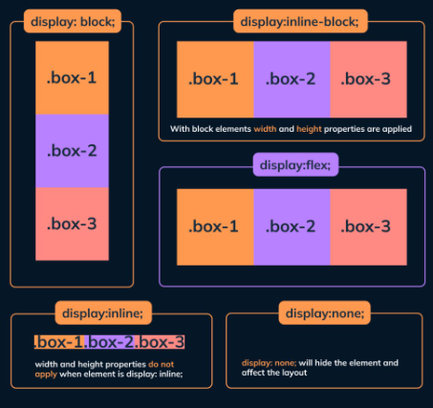
Display:
Display defines how an HTML element is rendered by the browser and how it interacts with its surrounding elements (its layout behavior).
Every HTML element has a default display value (like block for <div> or inline for <span>), but you can override this with CSS to change its behavior.

Slide 8
Value | Behavior | Characteristics | Default Examples
block | Takes up the full available width, forcing a line break before and after it. | Respects all width, height, margin, and padding properties. Stacks vertically. | <div>, <p>, <h1…6>
inline | Takes up only the necessary width, flowing with the text. | Ignores set width and height. Vertical margin/padding is ignored (but horizontal is respected). Flows horizontally. | <span>, <a>, <strong>
inline-block | Flows horizontally like an inline element but retains the box model properties of a block element. | Respects all width, height, margin, and padding properties. Flows horizontally with surrounding content. | <img> , <button> , <input>
flex | This activates the Flexbox layout model. The element becomes a flex container, and its direct children become flex items. Flexbox is designed for one-dimensional layouts (arranging items in a row or a column) and is excellent for navigation, aligning items, and distributing space.
none | This completely removes the element from the document flow. It is not rendered, and it does not occupy any space. It's often used in JavaScript to hide/show elements.

Slide 9
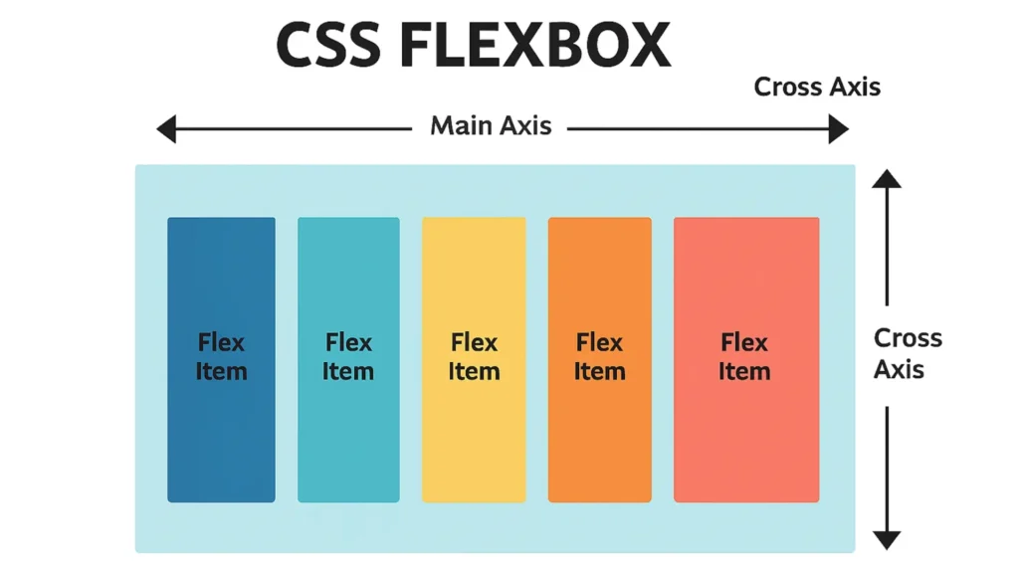

Flex box:
Flexbox is a CSS one-dimensional layout model designed to help you efficiently arrange, align, and distribute space among items in a container, even when the size of those items is unknown or dynamic.
Core Concepts:
Flexbox operates on the relationship between a container and its items:
Flex Container: The parent element on which you apply display: flex. This element controls the layout behavior of its direct children.
Flex Items: The direct children of the flex container. Their positioning and sizing are controlled by the container's properties.
Main Axis: The primary direction in which flex items are laid out (either horizontally as a row or vertically as a column).
Cross Axis: The axis perpendicular to the main axis.

Slide 10
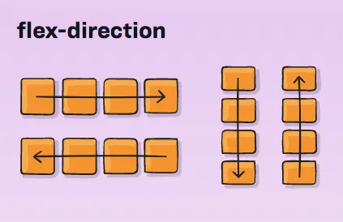
Flex container:
The properties applied to the container control the direction, alignment, and wrapping of the flex items within it.
1- flex-direction
This defines the primary axis (the main axis) along which flex items are laid out.
Value | Main Axis Direction
row (default) | Items are arranged horizontally, from left to right (or right to left, depending on the writing mode).
row-reverse | Items are arranged horizontally, from right to left.
column | Items are arranged vertically, from top to bottom.
column-reverse | Items are arranged vertically, from bottom to top.

Slide 11
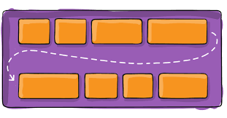
Flex container:
2- flex-wrap
By default, all flex items attempt to fit onto a single line. This property defines whether items should wrap onto multiple lines if they exceed the container's width/height.
Value | Behavior
nowrap (default) | All items stay on a single line, potentially causing overflow.
wrap | Items wrap onto multiple lines, stacking top-to-bottom if the direction is row.
wrap-reverse | Items wrap onto multiple lines, stacking bottom-to-top if the direction is row.

Slide 12
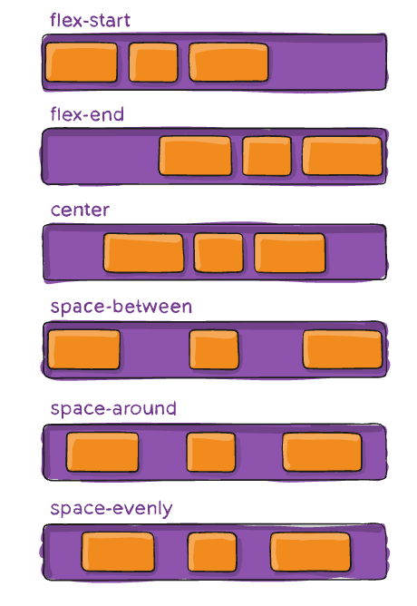
Flex container:
3- flex-flow (Shorthand)
This is a shorthand property that combines flex-direction and flex-wrap.
Syntax: flex-flow: <flex-direction> <flex-wrap>;
Example: flex-flow: row wrap;
4-justify-content
This property controls the alignment of items along the Main Axis (the direction set by flex-direction). It's used when there is extra space in the container.

Slide 13
Flex container:
4-justify-content
Value | Description
flex-start (default) | Items are packed toward the start of the main axis.
flex-end | Items are packed toward the end of the main axis.
center | Items are centered along the main axis.
space-between | Items are evenly distributed; the first item is at the start, and the last is at the end.
space-around | Items are evenly distributed with equal space around them (the space at the ends is half the space between items).
space-evenly | Items are evenly distributed with equal space both between items and at the ends.

Slide 14
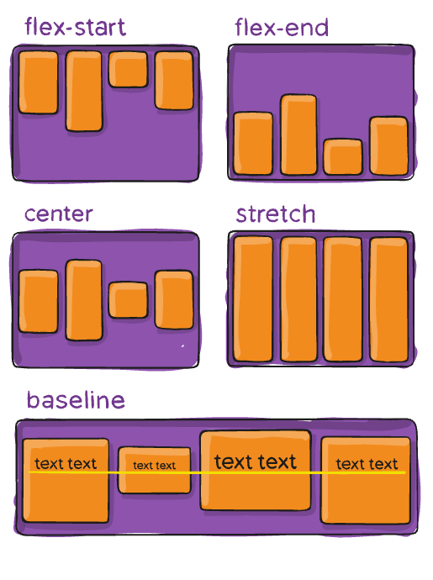
Flex container:
5- align-items:
This property controls the alignment of items along the Cross Axis (perpendicular to the main axis).
Value | Description
stretch (default) | Items are stretched to fill the container along the cross axis (respecting min/max-width/height).
flex-start | Items are packed toward the start of the cross axis.
flex-end | Items are packed toward the end of the cross axis.
center | Items are centered along the cross axis.
baseline | Items are aligned based on their contents' baselines.

Slide 15
Flex container:
5- align-items:
Value | Description
flex-start (default) | Items are packed toward the start of the main axis.
flex-end | Items are packed toward the end of the main axis.
center | Items are centered along the main axis.
space-between | Items are evenly distributed; the first item is at the start, and the last is at the end.
space-around | Items are evenly distributed with equal space around them (the space at the ends is half the space between items).
space-evenly | Items are evenly distributed with equal space both between items and at the ends.

Slide 16
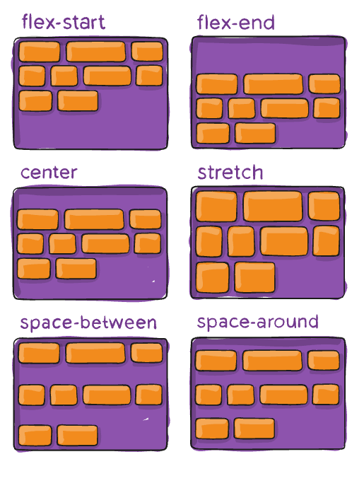
Flex container:
6- align-content
This property is similar to justify-content but works for the Cross Axis and is only effective when items wrap (flex-wrap: wrap) onto multiple lines. It controls how those wrapped lines are distributed when there is extra space.

Slide 17
Flex container:
6- align-content
Value | Description
stretch (default) | Lines stretch to take up the remaining space.
flex-start | Lines are packed toward the start of the cross axis.
flex-end | Lines are packed toward the end of the cross axis.
center | Lines are centered in the container.
space-between | Lines are evenly distributed; the first line is at the start, and the last is at the end.
space-around | Lines are evenly distributed with equal space around them.
space-evenly | Lines are evenly distributed with equal space both between lines and at the ends.

